Slide 1
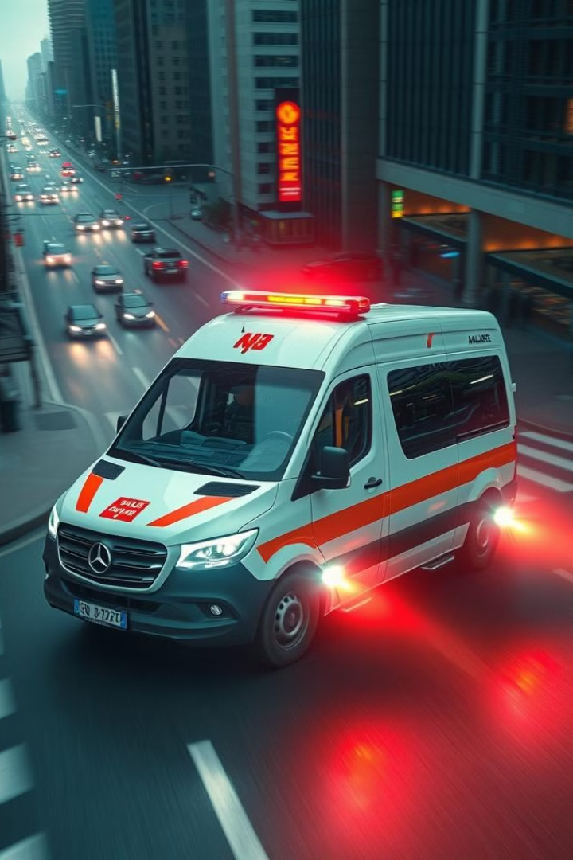
Taxi Ambulance: Revolutionizing Emergency Response
Imagine a world where emergency medical help arrives within minutes. This presentation details our solution for faster, more efficient ambulance services using readily available taxis.

Slide 2
The Problem: Critical Ambulance Shortage
Insufficient Resources
Delayed Response
Traffic Congestion
India faces a severe shortage of ambulances, even in major cities.
Critical time is lost waiting for ambulances, impacting patient outcomes.
Heavy traffic further delays ambulance arrival, exacerbating the situation.

Slide 3

Our Solution: Taxi-Based Emergency Response
Web App-Based Taxi Integration
Facial Recognition
Real-time Tracking
Utilizing nearby taxis equipped with basic medical kits for immediate response.
Notifying family members and emergency contacts with patient identification.
Live ride tracking for dispatchers, hospitals, and family members.

Slide 4
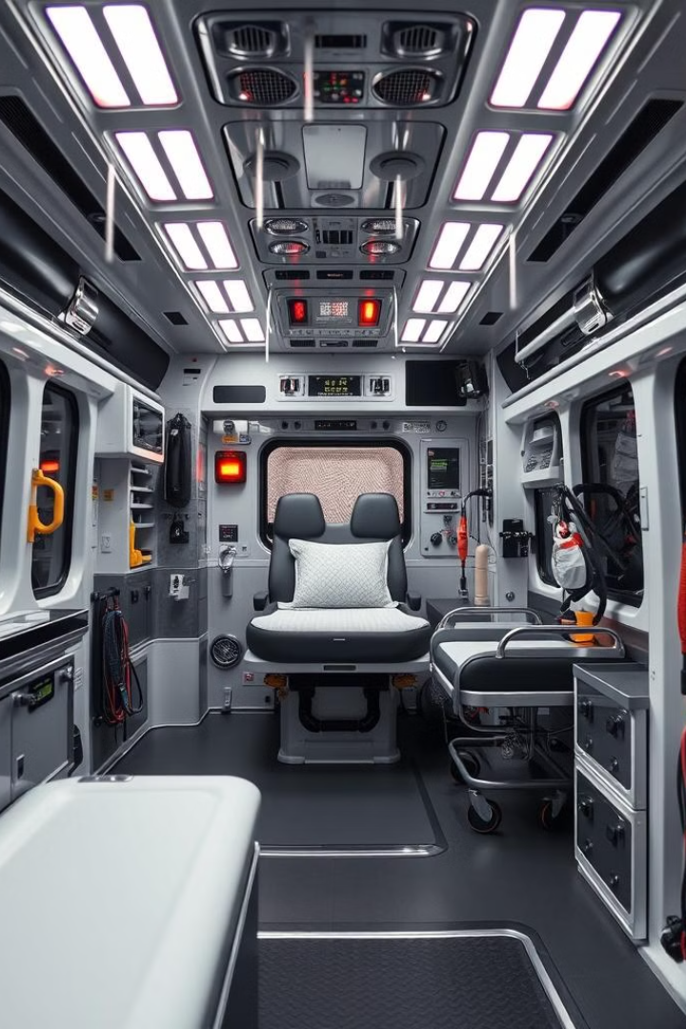
Enhanced Features for Critical Emergencies
1
Specialized Ambulances
2
Hospital Notification
Automatic alerts to hospitals preparing them for patient arrival.
Integrating traditional ambulances for critical care and specialized equipment.
3
Traffic Management
Notifying traffic police for route optimization and traffic clearance.

Slide 5





Tech Stack: Powering Our App
Mobile
Backend
Database
React Native
Node.js with Express
MongoDB Atlas
Mapping
Google Maps API
We leverage the best tools for a scalable, reliable, and user-friendly experience.

Slide 6
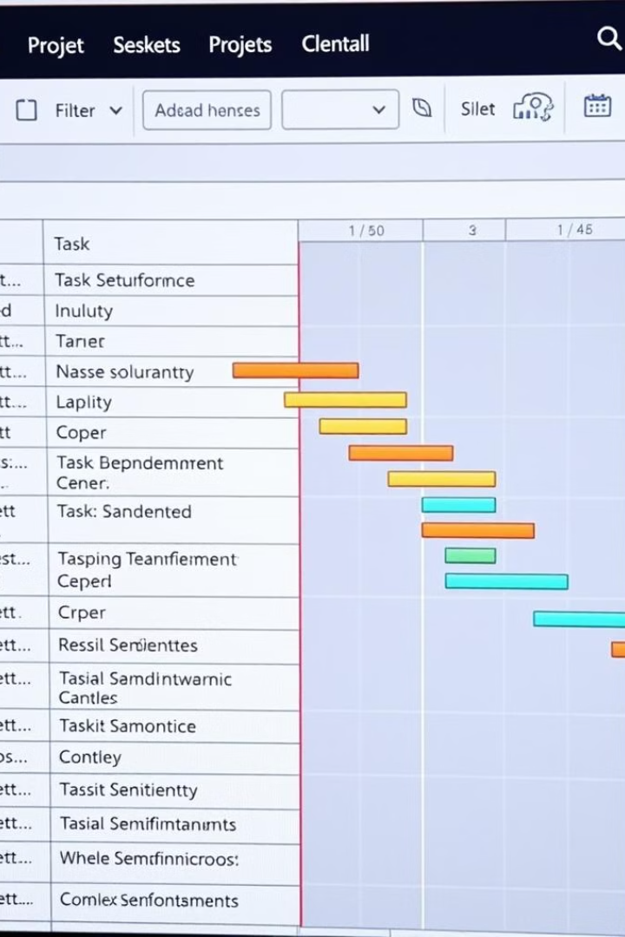




Implementation Plan: Step-by-Step Rollout
Pilot Program
Launch in select cities for testing and refinement.
Partnerships
Collaborate with taxi services and hospitals.
Training
Equip drivers with basic first aid knowledge.
Full-Scale Deployment
Expand operations across the country.

Slide 7



Scalability and Future Prospects
1
Global Expansion
2
Integration
3
Data Analysis
Our solution is designed for scalability, with potential for integration into existing emergency systems. By collecting and analyzing data we can optimize ambulance allocation, enhance predictive capabilities, and improve our understanding of medical needs.

Slide 8

Key Takeaways and Next Steps
Faster emergency response using readily available taxis.
Enhanced features for critical care emergencies.
Scalable tech stack for future growth.
Let's work together to make this life-saving innovation a reality. Next steps: finalize pilot program, secure partnerships, and begin driver training.

